Slide 1
Rock-Paper-Scissors with Hand Gesture Recognition Using Deep Learning

Slide 2
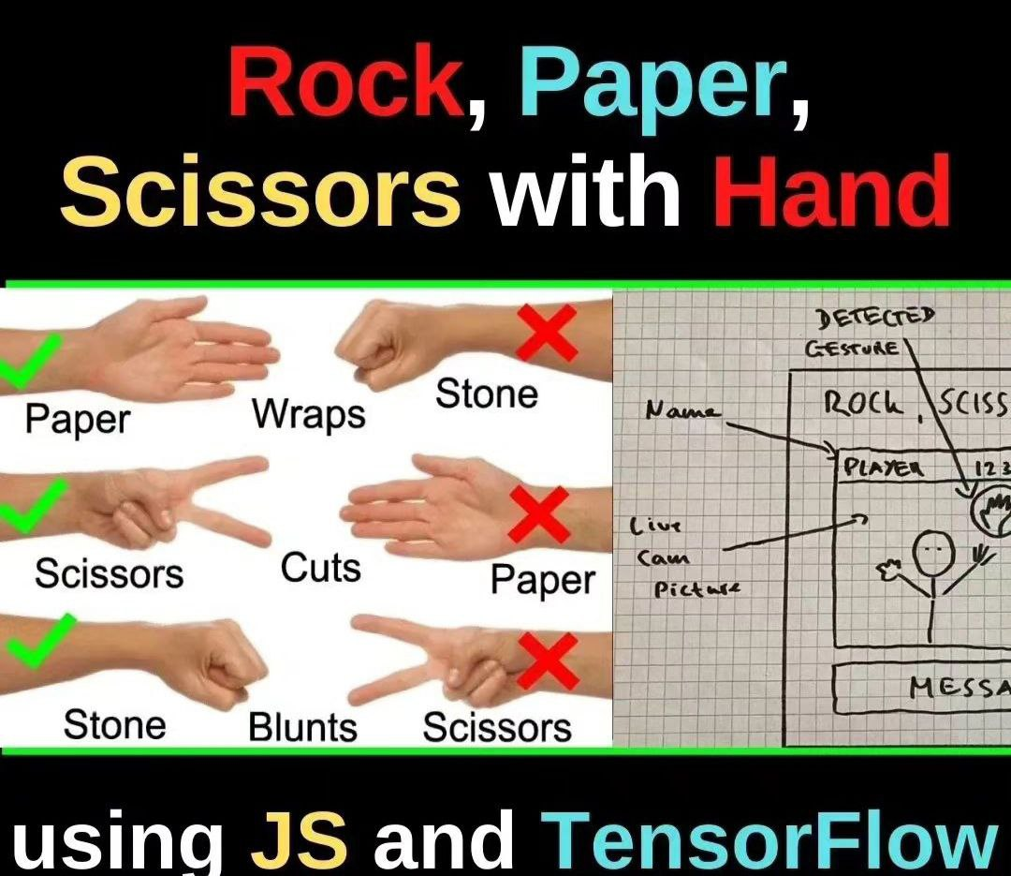
Introduction
What is Rock-Paper-Scissors?
Why use Hand Gesture Recognition?
What is Deep Learning?
How does it work?
Conclusion

Slide 3
Introduction: Highlighting the objective of the analysis.
Welcome to the world of Rock-Paper-Scissors, where hand gestures can determine your fate! But what if I told you that there's a new way to play this classic game, one that involves cutting-edge technology and deep learning algorithms? That's right, we're talking about Rock-Paper-Scissors with Hand Gesture Recognition using Deep Learning!
In today's fast-paced world, where technology is advancing at an unprecedented rate, it's important to stay ahead of the curve. By combining the age-old game of Rock-Paper-Scissors with the latest in AI and machine learning, we can create a truly innovative and exciting experience. Not only does this technology add a new level of fun and excitement to the game, but it also has practical applications in fields like robotics and automation. So buckle up and get ready to enter the world of Rock-Paper-Scissors 2.0!

Slide 4
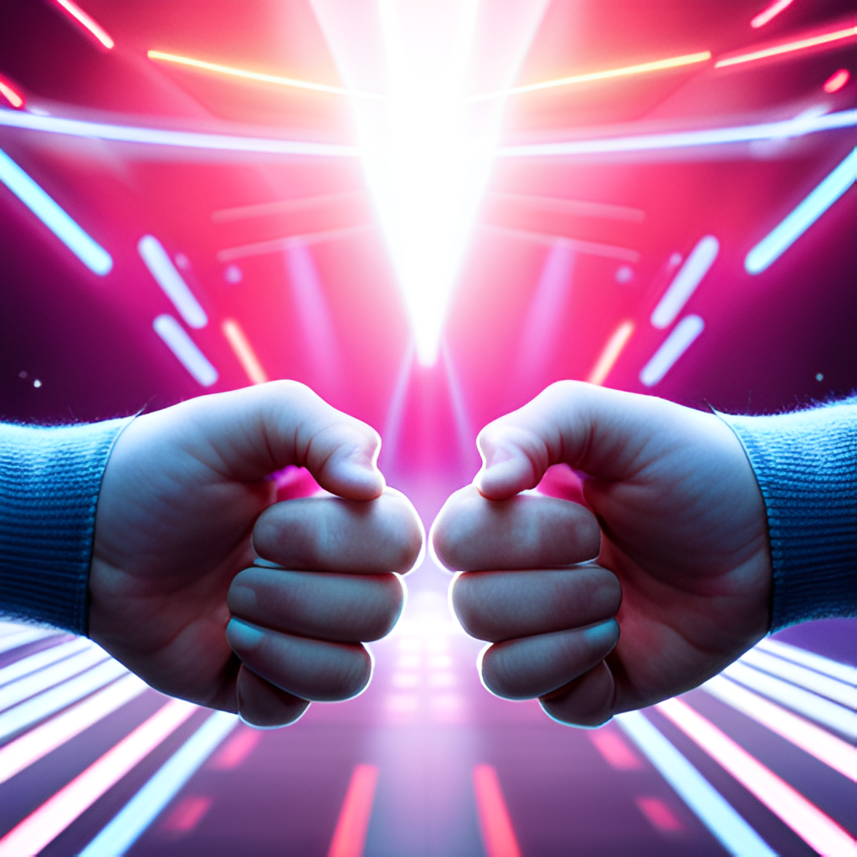
What is Rock-Paper-Scissors?
Rock-Paper-Scissors is a popular hand game played by people of all ages around the world. The objective of the game is to choose one of three hand gestures that will beat the opponent's choice. The three gestures are rock, paper, and scissors. Rock beats scissors, scissors beat paper, and paper beats rock.
The game is typically played with two players: human and robot. Each player simultaneously makes their gesture by forming their hand into the corresponding shape. The winner is determined by which gesture beats the other. In the case of a tie, the game is usually replayed until there is a clear winner.

Slide 5
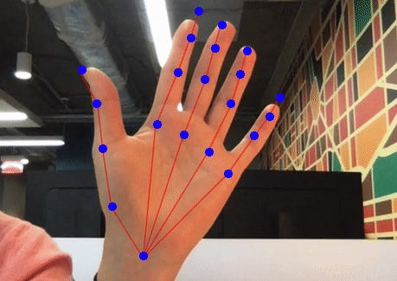
Why use Hand Gesture Recognition?
Hand Gesture Recognition is a game-changer for Rock-Paper-Scissors. It allows players to use their hands as controllers, making the game more immersive and interactive. Unlike traditional methods of playing the game, Hand Gesture Recognition adds an element of strategy and skill that can't be replicated with simple button presses.
Another advantage of Hand Gesture Recognition is its accuracy. With this technology, players can be sure that their moves are being recognized correctly, eliminating any potential for cheating or mistakes. This makes the game more fair and enjoyable for everyone involved.

Slide 6
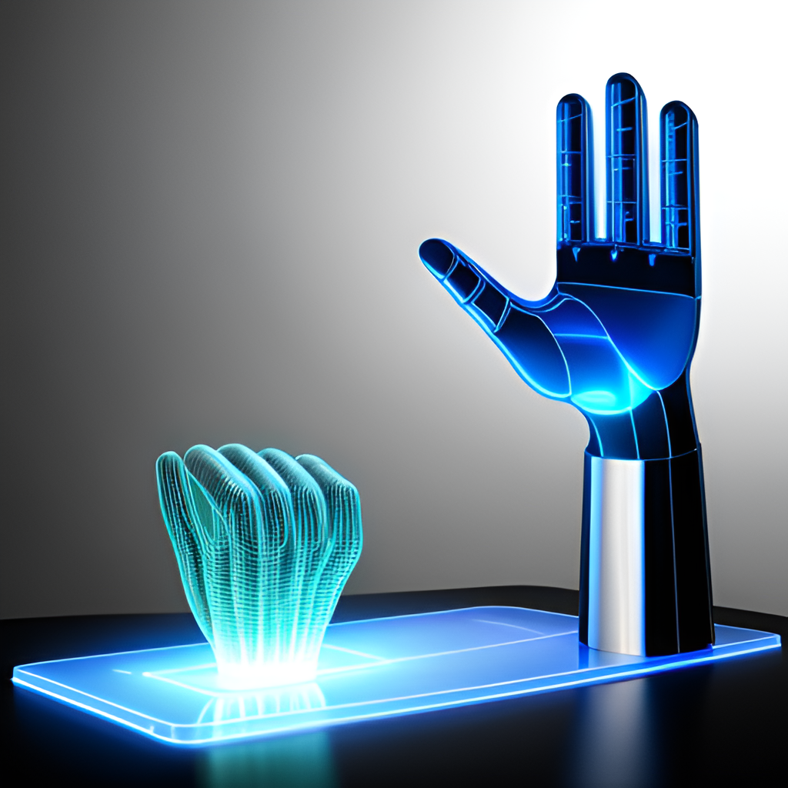
What is Deep Learning?
Deep Learning is a subset of Machine Learning that involves training artificial neural networks to learn and make decisions based on large datasets. These networks are modeled after the human brain, with layers of interconnected nodes that process information and generate outputs. In the context of Hand Gesture Recognition for Rock-Paper-Scissors, Deep Learning algorithms can be trained on thousands of images of hand gestures to accurately recognize and classify them.
One example of Deep Learning in action is Google's AlphaGo program, which uses neural networks to play the ancient Chinese board game, Go. By analyzing millions of past games and learning from its mistakes, AlphaGo was able to defeat the world champion in a series of matches. Similarly, by training a neural network on a large dataset of hand gesture images, our system can accurately recognize and classify different gestures in real-time, allowing for seamless gameplay and an immersive experience.

Slide 7
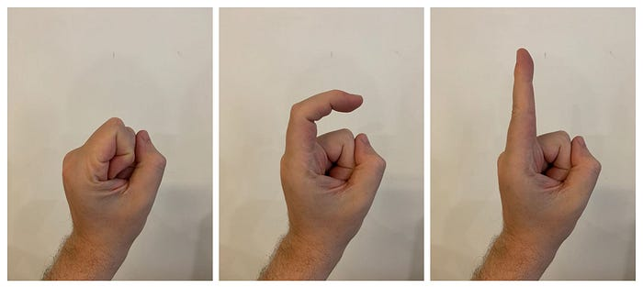
How does it work?
Hand Gesture Recognition using Deep Learning involves training a neural network to recognize different hand gestures corresponding to Rock, Paper, and Scissors. The first step is to collect a large dataset of images of hands making these gestures from various angles and lighting conditions. This dataset is then used to train the neural network to recognize the features that distinguish each gesture.
Once the neural network has been trained, it can be used to classify new images of hand gestures in real-time. The system captures an image of the player's hand using a camera, which is then processed by the neural network to determine the gesture being made. This information is then used to play the game of Rock-Paper-Scissors against an opponent.

Slide 8
Conclusion
In conclusion, we have explored the fascinating world of Rock-Paper-Scissors with Hand Gesture Recognition using Deep Learning. We learned that this technology has revolutionized the way we play this classic game, making it more interactive and engaging than ever before.
Through our discussion, we discovered the advantages of Hand Gesture Recognition over traditional methods of playing Rock-Paper-Scissors, as well as the power of Deep Learning in making this possible. We also delved into the technical aspects of how this technology works, highlighting its effectiveness and potential for future advancements.
As we move forward, it is important to recognize the significance of this technology in not just gaming, but also in other areas such as healthcare, robotics, and security. With further research and development, the possibilities are endless.
So let us embrace the exciting world of Rock-Paper-Scissors with Hand Gesture Recognition using Deep Learning, and see where this technology takes us.
Thank you for joining us on this journey. Now, it's time to put your skills to the test and challenge someone to a game of Rock-Paper-Scissors!

Slide 9
Links to the sources
https://github.com/alimoov/deep-learning-rock-paper

Slide 10
THANK YOU FOR YOUR ATTENTION!!!
Done by 2 students in pairs: Alimov Olimkhon
Egamberdiev Rustamjon

